Slide 1



Introduction to Kotlin in Android devel.

Slide 2
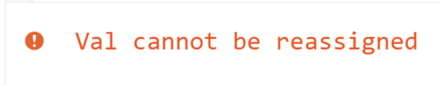
Variables
(Im)mutability variable_name: data_type = initial_value
Immutable (read only)
val x: Int = 5
Variable x can not be change
x = 6
It is recommended to start with (faster)
Mutable
var x: Int = 5
Variable x can be change
x = 6
Change from val to var only in necessity

Slide 3
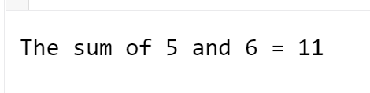
Functions
Name of the function
public fun sum(a: Int, b: Int): Int {
return a+b;
}
The arguments are separated by a comma
The return type of the function
The return statement
fun main() {
val a: Int = 5;
val b: Int = 6;
println("The sum of "+a+" and "+b+" = "+sum(a,b))
}
public fun sum(a: Int, b: Int): Int {
return a+b;
}
Try the code here:
https://developer.android.com/training/kotlinplayground

Slide 4
Function arguments
fun main() {
println(getWeather()) // will use the default values for the arguments
println(getWeather(10, "Windy")) // specifying values for 2 arguments, cond uses default.
println(getWeather(cond="raining" , wind="Windy"))
}
public fun getWeather(temp: Int = 0, wind: String = "not windy", cond: String ="Sunny"): String {
return "Today's Tempreture is "+ temp +". It is going to be "+ wind +", and it is expected to be "+ cond;
}
Changing the locations of the arguments is acceptable as long as you use the name of the variables and the not listed arguments have default values.
Default value incase no values sent to the argument

Slide 5

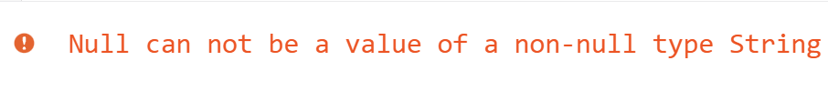
NULL Safety
fun main() {
println("The word cat is a length of "+getLength("cat"))
}
fun getLength(str: String): Int{
return str.length
}
fun main() {
println("The word cat is a length of "+getLength(null))
}
fun getLength(str: String): Int?{ //Int? means Int or null
return str.length
}
Try the code here:
https://developer.android.com/training/kotlinplayground

Slide 6


NULL Safety
fun main() {
println("The word cat is a length of "+getLength(null))
}
fun getLength(str: String?): Int?{
return str?.length
}
fun main() {
println("The word cat is a length of "+getLength(null))
}
fun getLength(str: String?): Int?{
return str?.length ?: 0 // ?: means if null return zero
}
Try the code here:
https://developer.android.com/training/kotlinplayground

Slide 7
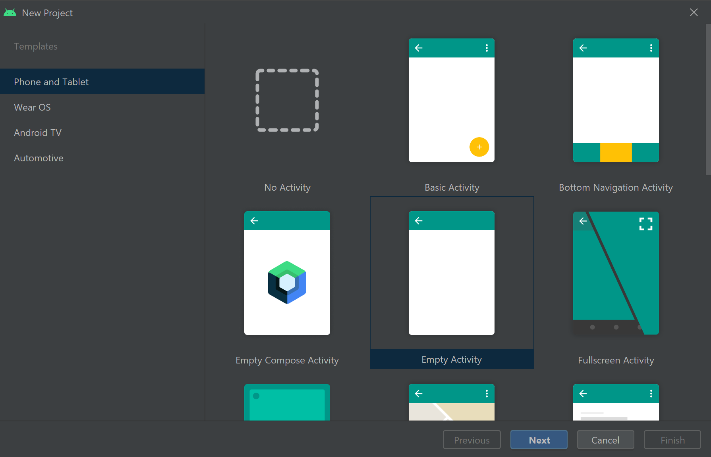

Slide 8
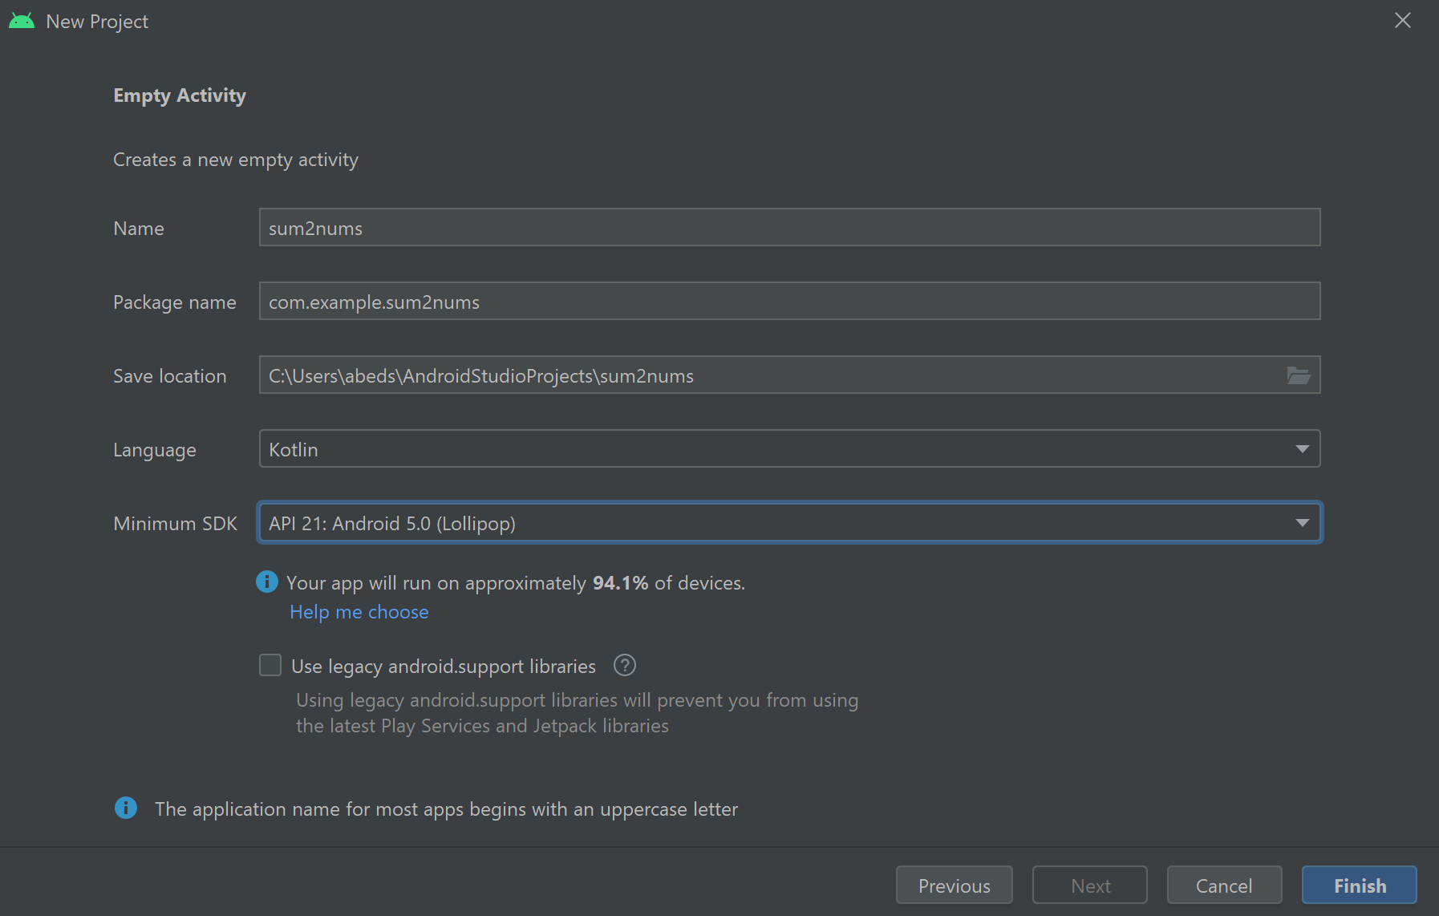

Slide 9
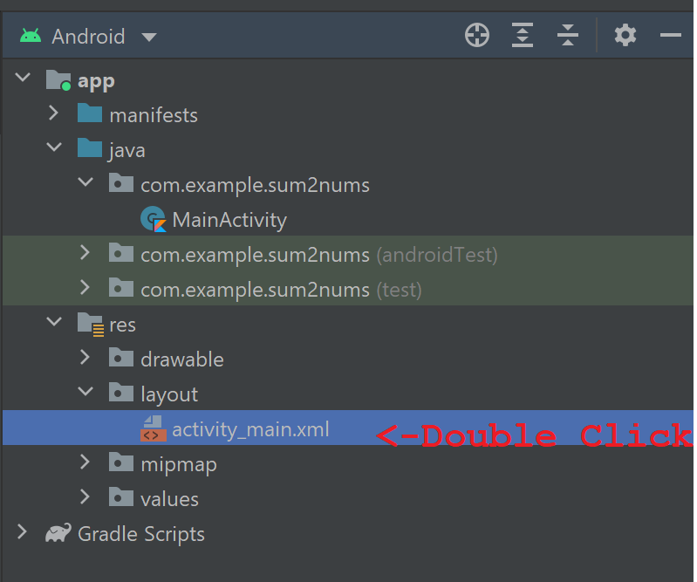
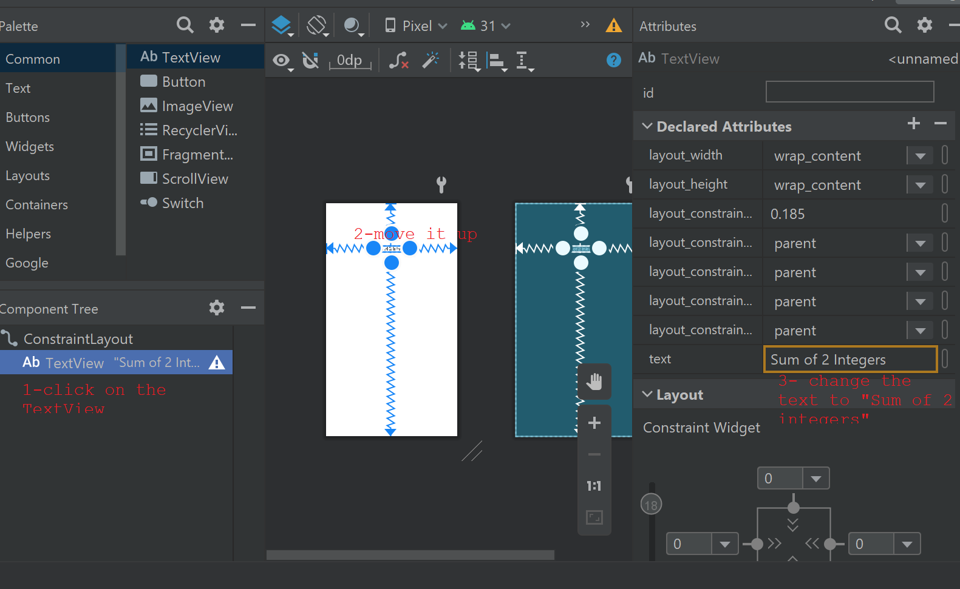
Change the “textview”

Slide 10
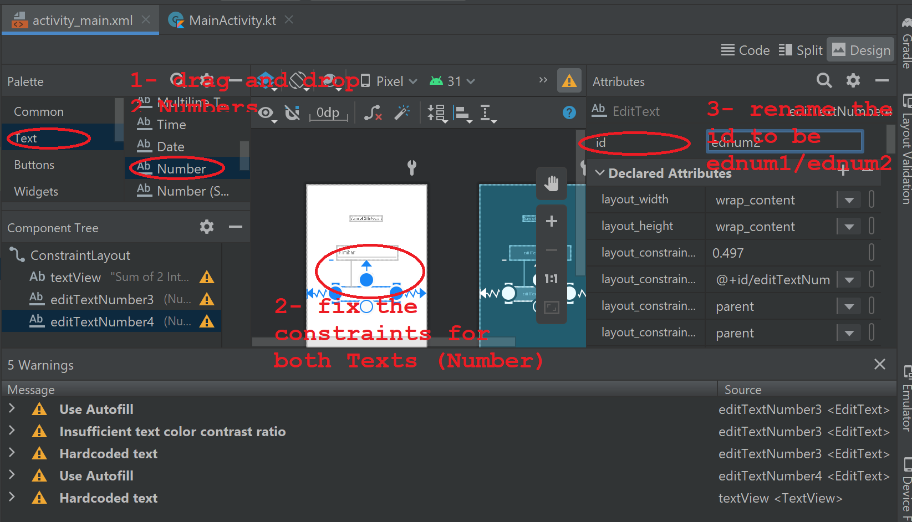
Add 2 “Number” views

Slide 11
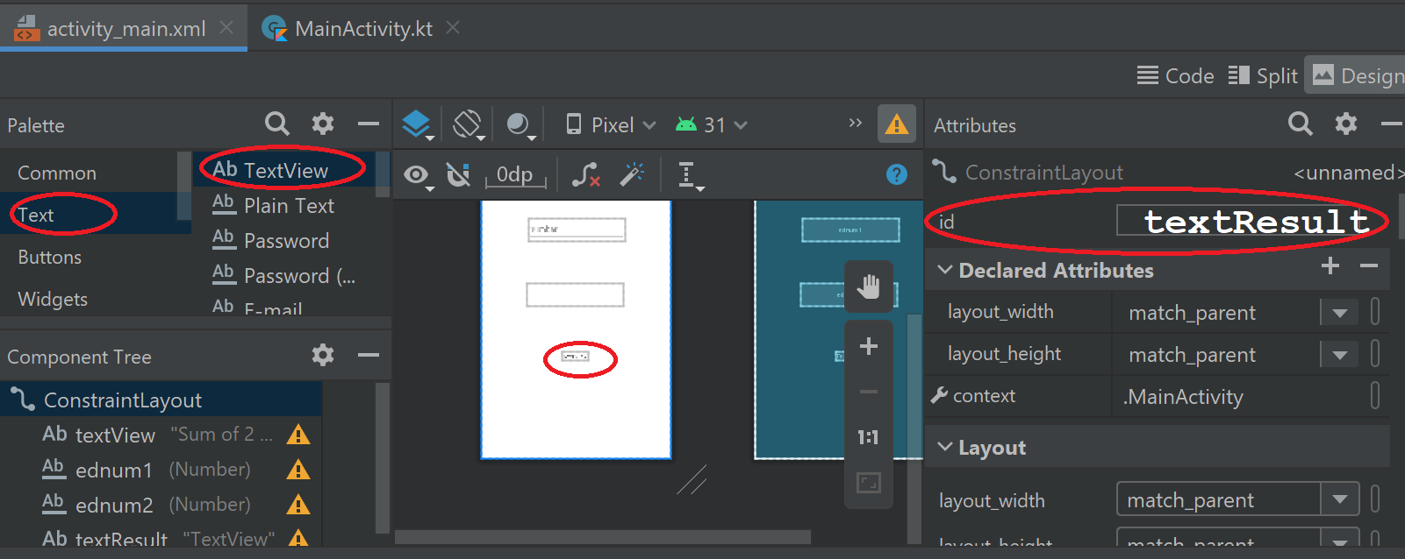
Add Result “TextView”
Also change the textsize
in the attributes to be
24sp
And
Change the text to be “Result”

Slide 12
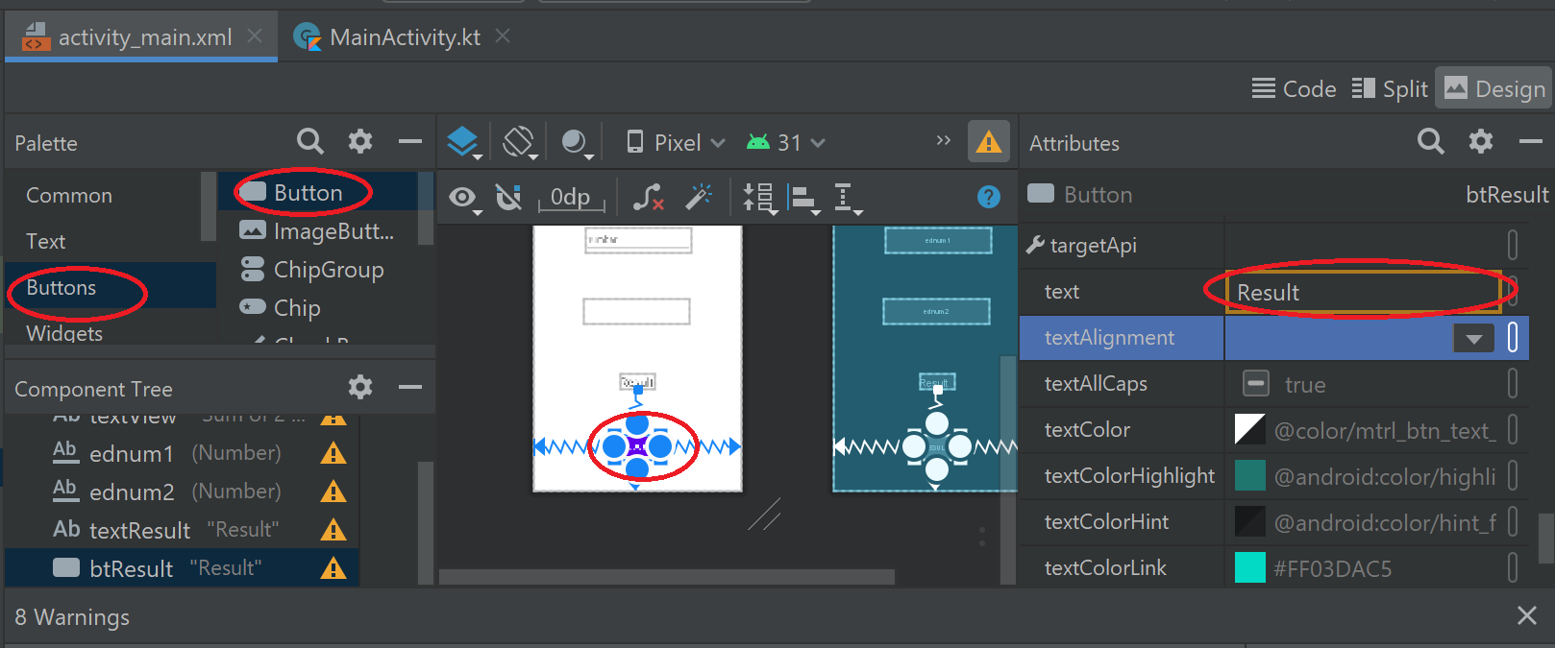
Add a button
Also change the id
To be “btResult”
And
Change the text to be “Result”

Slide 13
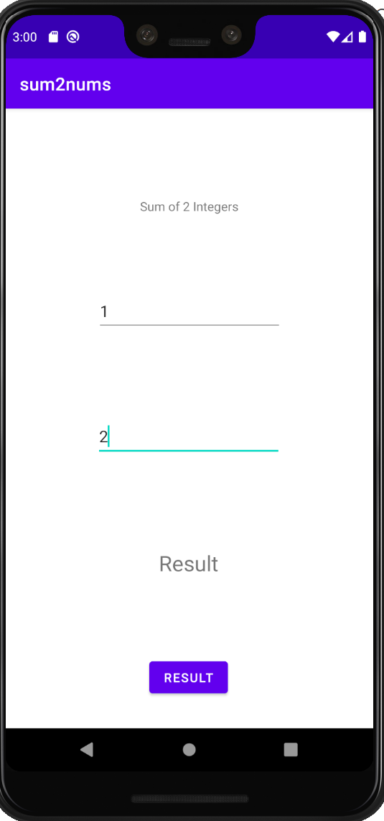
Run the app

Slide 14
Coding in MainActivity.kt
package com.example.sum2nums
Import ..
class MainActivity : AppCompatActivity() {
override fun onCreate(savedInstanceState: Bundle?) {
super.onCreate(savedInstanceState)
setContentView(R.layout.activity_main)
}
}
public fun sum(a: Int, b: Int): Int {
return a+b;
}

Slide 15
Adding setOnClickListener to the btResult
package com.example.sum2nums
Import ..
import android.widget.Button //to reach any button widget (view)
class MainActivity : AppCompatActivity() {
override fun onCreate(savedInstanceState: Bundle?) {
super.onCreate(savedInstanceState)
setContentView(R.layout.activity_main)
val button: Button = findViewById(R.id.btResult) // to variable button to btResult
button.setOnClickListener{ view ->
}
}
}

Slide 16
Also import EditText and TextView widgets
package com.example.sum2nums
Import ..
import android.widget.Button //to reach any button widget (view)
import android.widget.EditText //to reach any EditText widget (view)
import android.widget.TextView //to reach any TextView widget (view)

Slide 17
Using *
package com.example.sum2nums
Import ..
import android.widget.*// to access Button, EditText, TextView or any // class inside widget

Slide 18
Creating widgets(views) variables
setContentView(R.layout.activity_main)
val button: Button = findViewById(R.id.btResult)
val edtxt1: EditText = findViewById(R.id.ednum1)
val edtxt2: EditText = findViewById(R.id.ednum2)
val resultTV: TextView = findViewById(R.id.textResult)
button.setOnClickListener{ view -> ……

Slide 19
The addition
button.setOnClickListener{ view ->
// reading what in edText1, edText2, notice that you read it as text, //text can be converted to “toString” then can be converted to “toInt”
var x: Int = edtxt1.text.toString().toInt();
var y: Int = edtxt2.text.toString().toInt();
//sum retun int, it needs to be changed to “toString” before assign it to //the text attribute of the EditView
resultTV.text = sum(x,y).toString();
}

Slide 20
The full text MainActivity.kt
package com.example.sum2nums
import androidx.appcompat.app.AppCompatActivity
import android.os.Bundle
import android.widget.*
class MainActivity : AppCompatActivity() {
override fun onCreate(savedInstanceState: Bundle?) {
super.onCreate(savedInstanceState)
setContentView(R.layout.activity_main)
val button: Button = findViewById(R.id.btResult)
val edtxt1: EditText = findViewById(R.id.ednum1)
val edtxt2: EditText = findViewById(R.id.ednum2)
val resultTV: TextView = findViewById(R.id.textResult)
button.setOnClickListener{ view ->
var x: Int = edtxt1.text.toString().toInt();
var y: Int = edtxt2.text.toString().toInt()
resultTV.text = sum(x,y).toString();
}
}
}
public fun sum(a: Int, b: Int): Int {
return a+b;
}

Slide 21
References
https://www.usna.edu/Users/cs/adina/teaching/it472/spring2021/course/page.php?shortname=mobileos&id=5
Getting started with Kottlin, Dhrutin Ahir, 2021.
https://www.youtube.com/watch?v=jv9LFydMiwA&t=288s

